Slide 1

Groupon Goods REFUND RATES
2
+
RamMohan. Chubata. Infante. Huang

Slide 2


AGENDA
2
+
2
+
Introduction
Background
Business Case
Data Overview
Exploratory Analysis
Cleaning and Transformation
Understanding refunds and their drivers
Modeling
Business Insights
Areas of Improvement
Next Steps

Slide 3
background
introduction
Company profile
Groupon, Inc. is an online local commerce marketplace around the world connecting merchants to consumers by offering goods, services and travel deals at a discounted price.
WHAT IS GROUPON GOODS
Groupon Goods division offers customers the ability to find deals on merchandise across various product lines like electronics, sporting goods, jewelry, toys, household items and apparel. They offer their vendors a unique channel to build their brand, launch new products, and potentially sell more product in a three-day window than most e-commerce channels could sell in months

Slide 4
Business Problem
Refund rates are going down …. but not enough.
The objective of this project was to conduct an analysis of what is driving refunds. If any particular refund sub-buckets are driving the majority of refunds and to identify any seasonality trends.

Slide 5
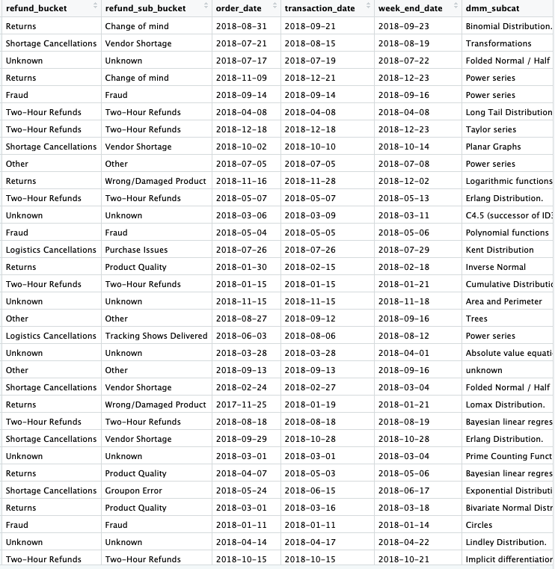
DATASET OVERVIEW
2
+
Dataset : Year 2016 - 2019 data
Description : Summary of features of refunds and transactions by Groupon Goods in a period of 13 quarters.
6,831,276 observations
16 attributes :
refund bucket buyer name
refund sub bucket authorized booking
order date captured bookings
transaction date refunds
week end date cancel refunds
product subcategory refunded units
product category authorized refunds
deal supply channel captured units

Slide 6
Title
CLEANING
TRANSFORMATION
The dataset did not consist of too many inconsistencies or irrelevant variables.
The column pertaining to supply chain which indicates Goods or Services was removed since the dataset consisted of only Groupon Goods.
Missing values in the dataset were represented by ‘?’. These were transformed into “Unknown” for character variables and “0” for numeric variables.
The dates in the dataset were transformed into date format from factor format in R.

Slide 7
Refund rate by month

Slide 8
2016
2017
2018
2019
10.78
9.15
5.83
4.14
$159 MILLION
$72.4 MILLION

Slide 9
CURRENT STATE
REFUND BUCKET
6 refund buckets , 17 refund sub buckets
Two hour refunds : ~ 96million , ~ 27% of the total refunds
Returns : ~51%
Logistic cancellations : ~14% of the total refunds
CATEGORY
13 categories , 140 sub categories.
Calculus II lost ~110 million in refunds ,refund rate of 11.32%
Probability I and II : refund rates of 9.41% and 7.52% respectively.
BUYER
356 buyers
Asher has the highest amount of refund at 20.55 million and refund rate of 9.37%
Grace has high refund rate of 19.35% primarily in the Category Calculus II

Slide 10
Seasonality
e x p l o r a t o r y d a t a a n a l y s i s
2
+
33% of refunds in Nov, Dec and Jan
Calculus || has the highest refunds and highest transactions in October through January
The highest issues causing refunds at said time :
Product Quality
Change of Mind
Two Hour Refunds
Dead Tracking

Slide 11
INTERIM Findings
EXCLUDED FROM THE MODEL :
Two hour refunds : $96 million
Fraud : $9 million
Correlating Variables
Modeling

Slide 12
Influential Variables
REFUND BUCKET
PRODUCT CATEGORY
BUYER NAME
Purchase Issues*
Dead Tracking*
Return to Sender*
Logistics Cancellations
Returns
Change of Mind*
Tracking shows Delivered*
Vendor Shortage*
Maclaurin series*
Calculus ||*
Kumaraswamy Distribution*
Mixture Distribution*
Quadratic Equation*
Circle Importance*
Coordinate Plane Importance*
Asher
Audrey
Tessa
Juliette
Charles
Luke

Slide 13
Recommendations
We will evaluate three different insights to reduce refund rates :
1. REMOVING THE SUB BUCKET DEAD TRACKING :
Dead tracking : when the shipping label is created but the product is unaccounted for.
Once the shipping label is created, the customer’s card is charged even if the product wasn’t shipped.
$12,733,933.50
Majority refund requests from product categories ($6.5 million):
Calculus ||
Probability Distribution ||
Double loss for Groupon : Lost money, Lost product
Recommendation : Charge customer’s card after first movement.

Slide 14
Recommendations
We will evaluate three different insights to reduce refund rates :
2. REDUCING RETURN REFUND RATE :
Returns plays a significant role in the refund amount.
Product category : Calculus ||
sub category : Power Series and Maclaurin Series are returned the most.
Reason : Product Quality, Change of Mind, Wrong/Damaged Product and Wrong Size.
Buyer : Zoey in 2018, 2019
In 2018, for the category Calculus || : ~$6.9 million lost due to Product Quality.
Recommendations :
Charge the vendors if they surpass a certain rate of damaged products.
Look into customer reviews and improve product description to reduce Change of Mind Refunds

Slide 15
RECOMMENDATIONS
We will evaluate three different insights to reduce refund rates :
3. MACLAURIN SERIES
Maclaurin Series is a valuable product : ~$250 million dollars in revenue.
One of the highest sub categories of products
The buyers for this product have changed over the years and the overall refund rate has been decreasing relatively slower in comparison to the other products.
The primary reasons for refunds regarding this product are :
Product Quality : $10.9 million
Change of Mind : $10.7 million
Wrong/Damaged Product : $2.2 million
Recommendation : If Groupon is not comfortable charging all vendors under the Calculus || category, focus on Maclaurin Series.

Slide 16
Future state
The projection for the upcoming year (March 2019 – February 2020) in refunds :
~$43 million
If Groupon eliminates Dead Tracking sub bucket :
Save $1.6million
If Groupon reduces Return refunds by 2% :
Save ~$1 million
The Maclaurin series :
Projected revenue : $82.2 million
Projected refund amount : ~ $7 million

Slide 17

$2.7 million

